Slide 1
Linux device driver
Day 20 PPT
-SUBITHRA s

Slide 2
gdb
Setting breakpoints: breakpoints are markers placed in the code where the debugger should pause execution. This allows you to examine the program's state at specific points during execution and track down issues. Breakpoints can be set on lines of code, function names, or even specific memory addresses.
Stepping through code: gdb allows you to execute your program one instruction at a time, allowing you to trace the flow of execution. You can step into functions, step over lines of code, or step out of functions to quickly navigate through your code and identify potential problems.
Inspecting variables: while debugging, you can examine the values of variables in your program's memory. This allows you to track how data changes as the program executes and identify incorrect values or unexpected behavior.
Backtracing: gdb can generate a backtrace, which shows the call stack of your program at the current point of execution. This helps you understand how your program arrived at its current state and identify the sequence of function calls leading to an error.
Examining memory: gdb allows you to inspect the contents of memory locations while debugging. This is useful for identifying memory-related issues such as segmentation faults or buffer overflows.

Slide 3
gdb
Conditional breakpoints: gdb supports conditional breakpoints, which allow you to specify conditions under which the program should pause execution. This is useful for debugging complex control flow or when you only want to break under certain circumstances.
Watching variables: you can set up watchpoints on variables, causing the program to pause execution whenever the value of the variable changes. This is helpful for tracking down unexpected modifications to variables that may be causing errors.
Core dump analysis: gdb can analyze core dump files generated when a program crashes. This allows you to inspect the state of the program at the time of the crash and identify the cause of the error.
Remote debugging: gdb supports remote debugging, allowing you to debug programs running on a different machine or embedded device. This can be useful for debugging applications deployed in remote environments or on embedded systems.

Slide 4
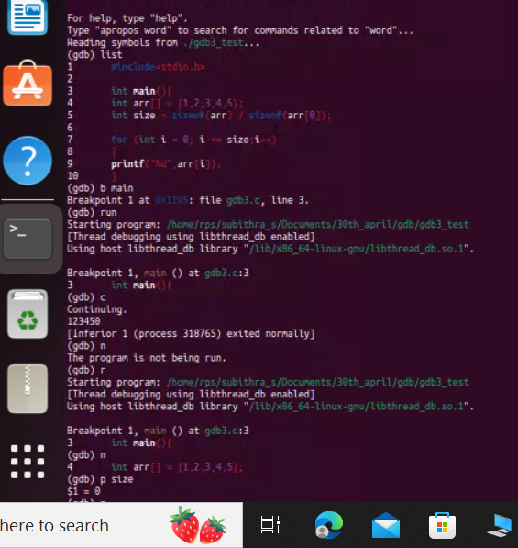
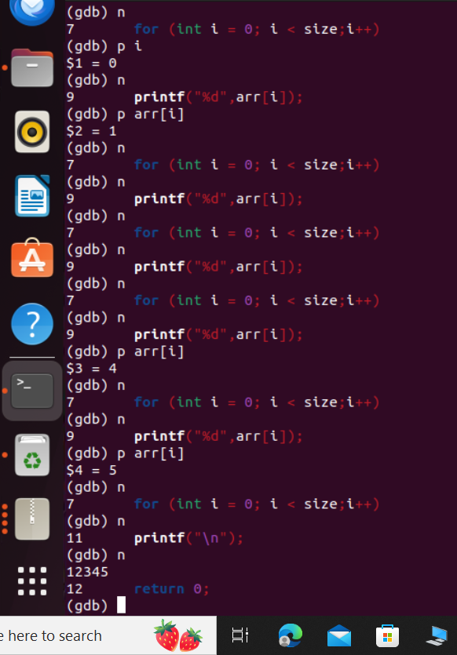
gdb

Slide 5
Clock function
The clock_t data type represents clock ticks, which is returned by the clock() function.
The clock() function returns the processor time consumed by the program since the beginning of its execution. It measures the time in clock ticks, which are units of time measured by the CPU. The value returned by clock() represents the CPU time used by the program, not the actual elapsed time.
The value returned by clock() is usually divided by the macro clocks_per_sec to convert it to seconds. CLOCKS_PER_SEC represents the number of clock ticks per second, which is a constant defined by the implementation.
It's important to note that clock() measures the cpu time used by the program, not the actual time passed. It doesn't account for time spent waiting for I/O operations or sleeping.

Slide 6
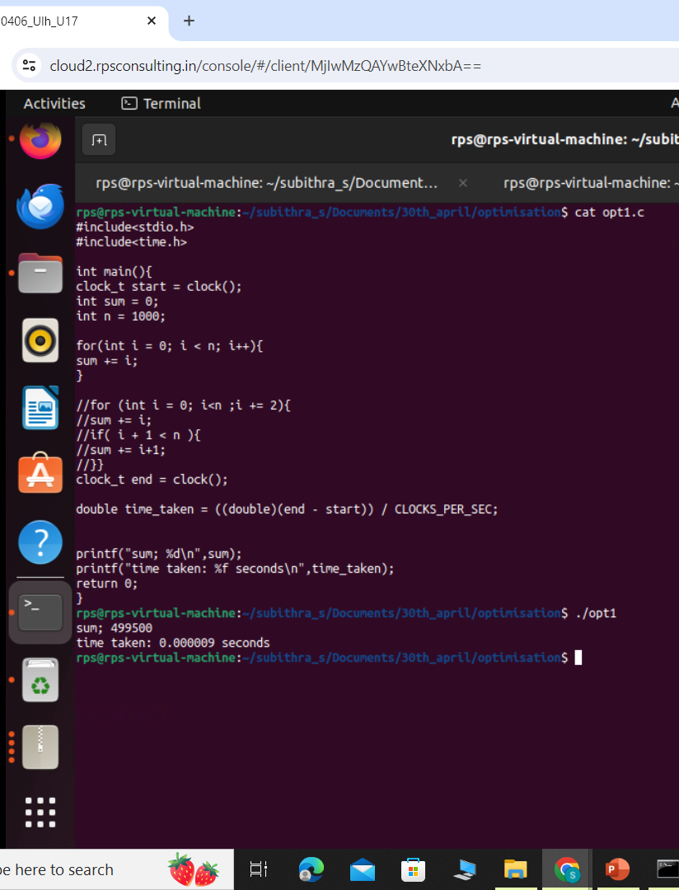

Clock function

Slide 7
optimization
-O1: this is the lowest level of optimization. It enables optimizations that do not typically increase compilation time significantly. These optimizations may include simple things like removing unused variables and inlining functions.
-O2: this is a moderate level of optimization. It includes all optimizations from -O1 and adds more aggressive optimizations that can improve performance but may also increase compilation time. These optimizations include loop optimizations, function inlining, and instruction scheduling.
-O3: this is the highest level of optimization. It includes all optimizations from -O2 and adds even more aggressive optimizations that can further improve performance. However, these optimizations can significantly increase compilation time and may not always provide noticeable improvements in program performance.

Slide 8
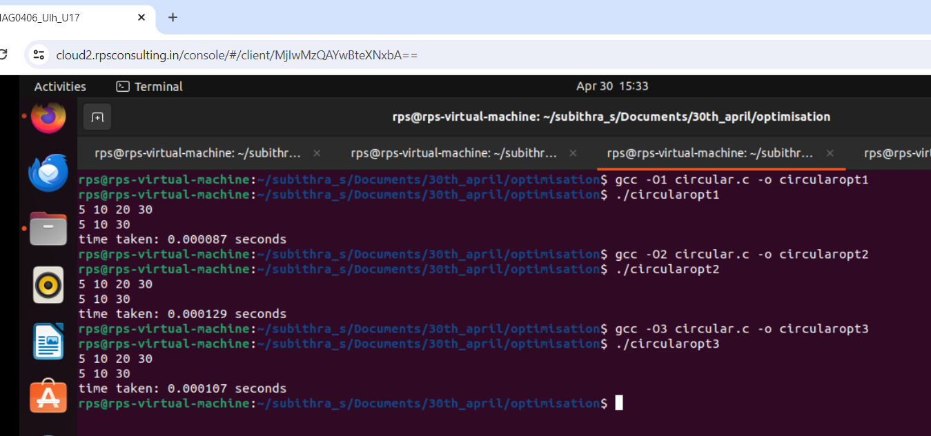
optimization

Slide 9
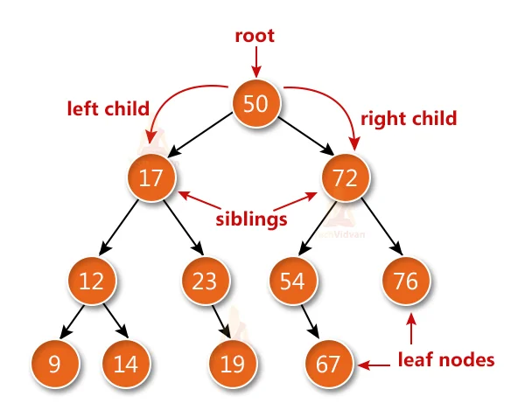
Binary tree
Root: The topmost node of the tree, from which all other nodes are descended.
Parent: A node that has one or more child nodes.
Child: Nodes that are connected to a parent node.
Leaf: A node that has no children.
Internal node: A node that has at least one child.
Depth: The length of the path from the root to a particular node. The depth of the root node is 0.

Slide 10
THANK YOU

